Slide 1

Board of Curators
EVC Report
Richard J. Barohn, MD
Executive Vice Chancellor for Health Affairs
Sept. 2, 2021
OPEN – HEALTH AFF – INFO 1-1

Slide 2
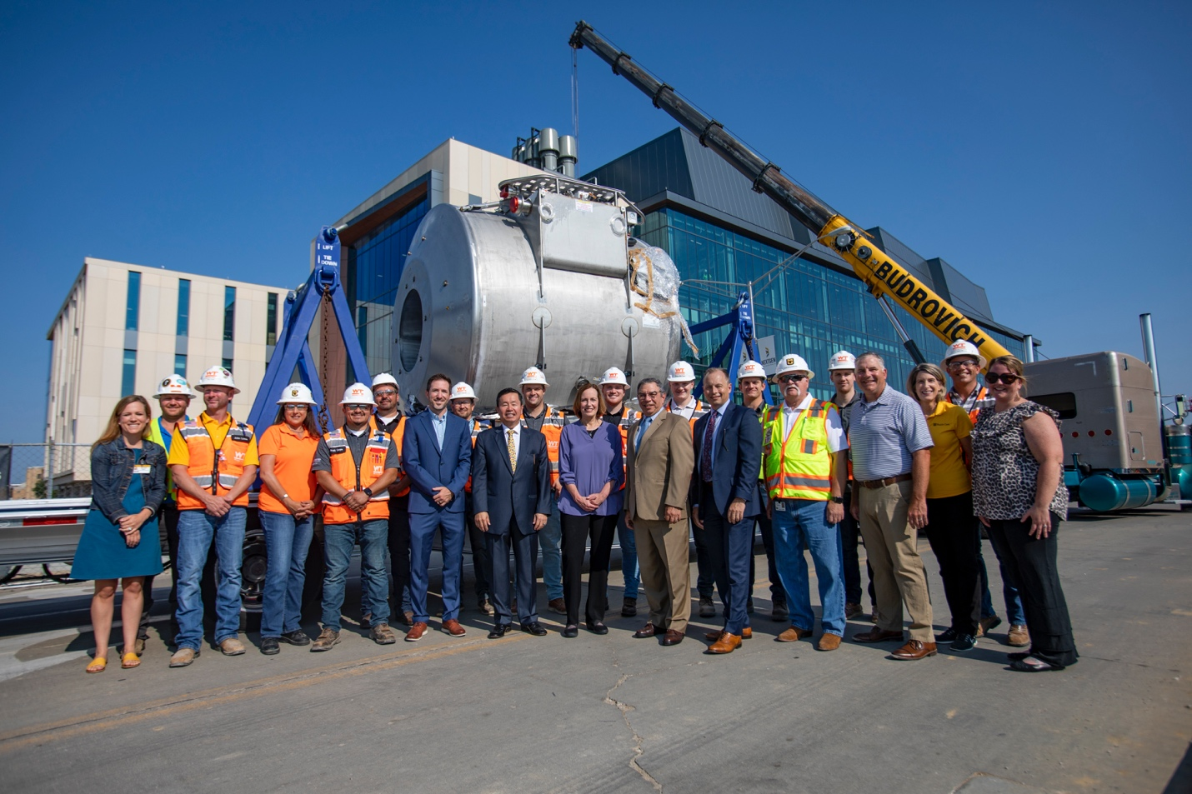
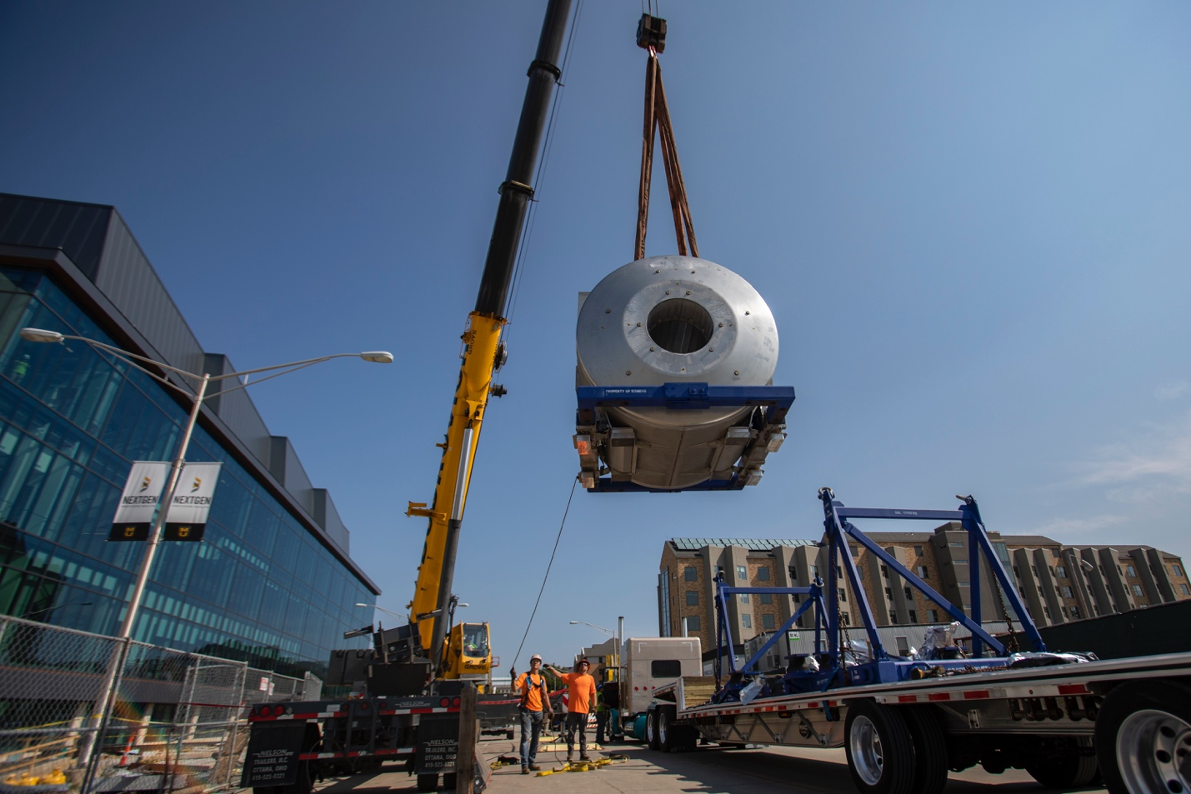
NextGen Precision Health Building Update
  Building is being outfitted
  Lab spaces are being finished
  Initial art, café, meeting room and visioning space almost complete
On August 4, 2021, the 25-ton Siemens Healthineers MAGNETOM Terra 7-Tesla magnetic resonance imaging scanner (7T MRI) was lifted into the air.
OPEN – HEALTH AFF – INFO 1-2

Slide 3
NextGen Precision Health – Grand Opening Events
Friday, October 15, 2021
Open House at NextGen Precision Health Building
Saturday, October 16, 2021
MU vs. Texas A&M football game and tailgate
Sunday, October 17, 2021
Alliance for Precision Health Dinner
Monday, October 18, 2021
NextGen Advisory Board meeting
Monday, October 18, 2021
Extension and Engagement Week kick off
Tuesday, October 19, 2021
Open house and special tours
Ribbon Cutting and Special Guests include:
Senator Roy Blunt
Board of Curators
Alliance for Precision Health – Siemens
All UM campus Chancellors
NextGen Advisory Board members
Extension and Engagement keynote speaker
Reception
OPEN – HEALTH AFF – INFO 1-3

Slide 4
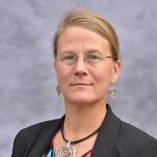
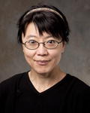
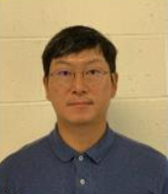
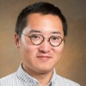
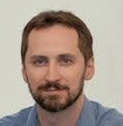
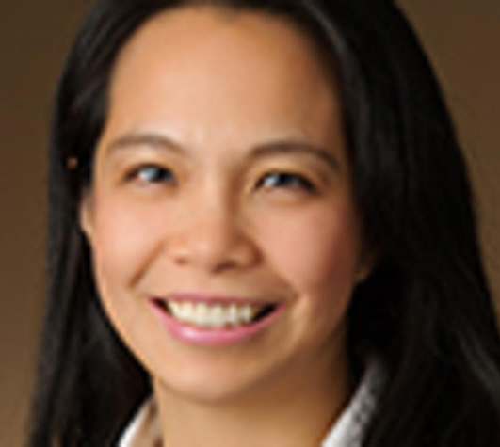
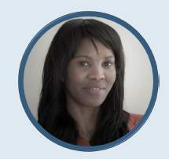
NextGen Imaging Hires: 6 New MRI Physicists, 1 Pending
    Melissa Terpstra, PhD
    Professor with tenure
    Director of NextGen Imaging
    From University of Minnesota
    Initiating NIH funding transfer
    Joint: Biomedical, Biological and Chemical Engineering (BBCE)
    Expertise: High Field MR Spectroscopy/Human Connectome Project
    Julie Pan, MD, PhD
    Professor with tenure
    Director of High Field MRI
    From University of Pittsburg
    NIH R01 transfer in process
    Expertise: High Field MRI
    Ai-Ling Lin, PhD
    Professor with tenure
    Vice Chair of Research, Radiology
    From University of Kentucky
    NIH R01 transfer in process
    Joint: Division Biological Sciences (DBS)
    Expertise: Translational imaging/Alzheimer’s
    Junghwan Kim, PhD
    Assistant Professor, tenure track
    From GE, University of Pittsburg
    Joint: Electrical Engineering and Computer Sciences (EECS)
    Expertise: MRI RF Engineering
    Changyu Sun, PhD
    Assistant Professor, tenure track
    From University of Virginia
    Primary: Biomedical, Biological and Chemical Engineering (BBCE)
    Expertise: Fast Image Reconstruction Algorithms/Pulse Sequence Programming
    John Grinstead, PhD
    Siemens Employee
    Adjunct Faculty: Radiology
    Prior Site: University of Oregon
    Expertise: High Field MRI
    Udunna Anazodo, PhD (Offer Pending)
    Assistant Professor, tenure track
    From Western University, Ontario Canada
    Joint: Biomedical, Biological and Chemical Engineering (BBCE)
    Expertise: Quantitative PET-CT and MRI

Slide 5
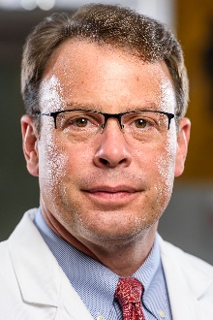
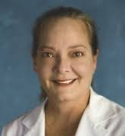
SOM Recruitment Updates and Growth
  Steve Barnes, MD, Chair of Surgery
    Chief of acute care surgery
    DOD supported trauma outcomes research
    Planning Chief for incident command
  Jean Ricci Goodman, MD, MBA, Chair of
  OBGYN and Women’s Health
    Chief of Maternal Fetal Medicine, Loyola
  School of Medicine, Chicago
    Funded research on gestational diabetes, wound infections, urinary microbiome

Slide 6
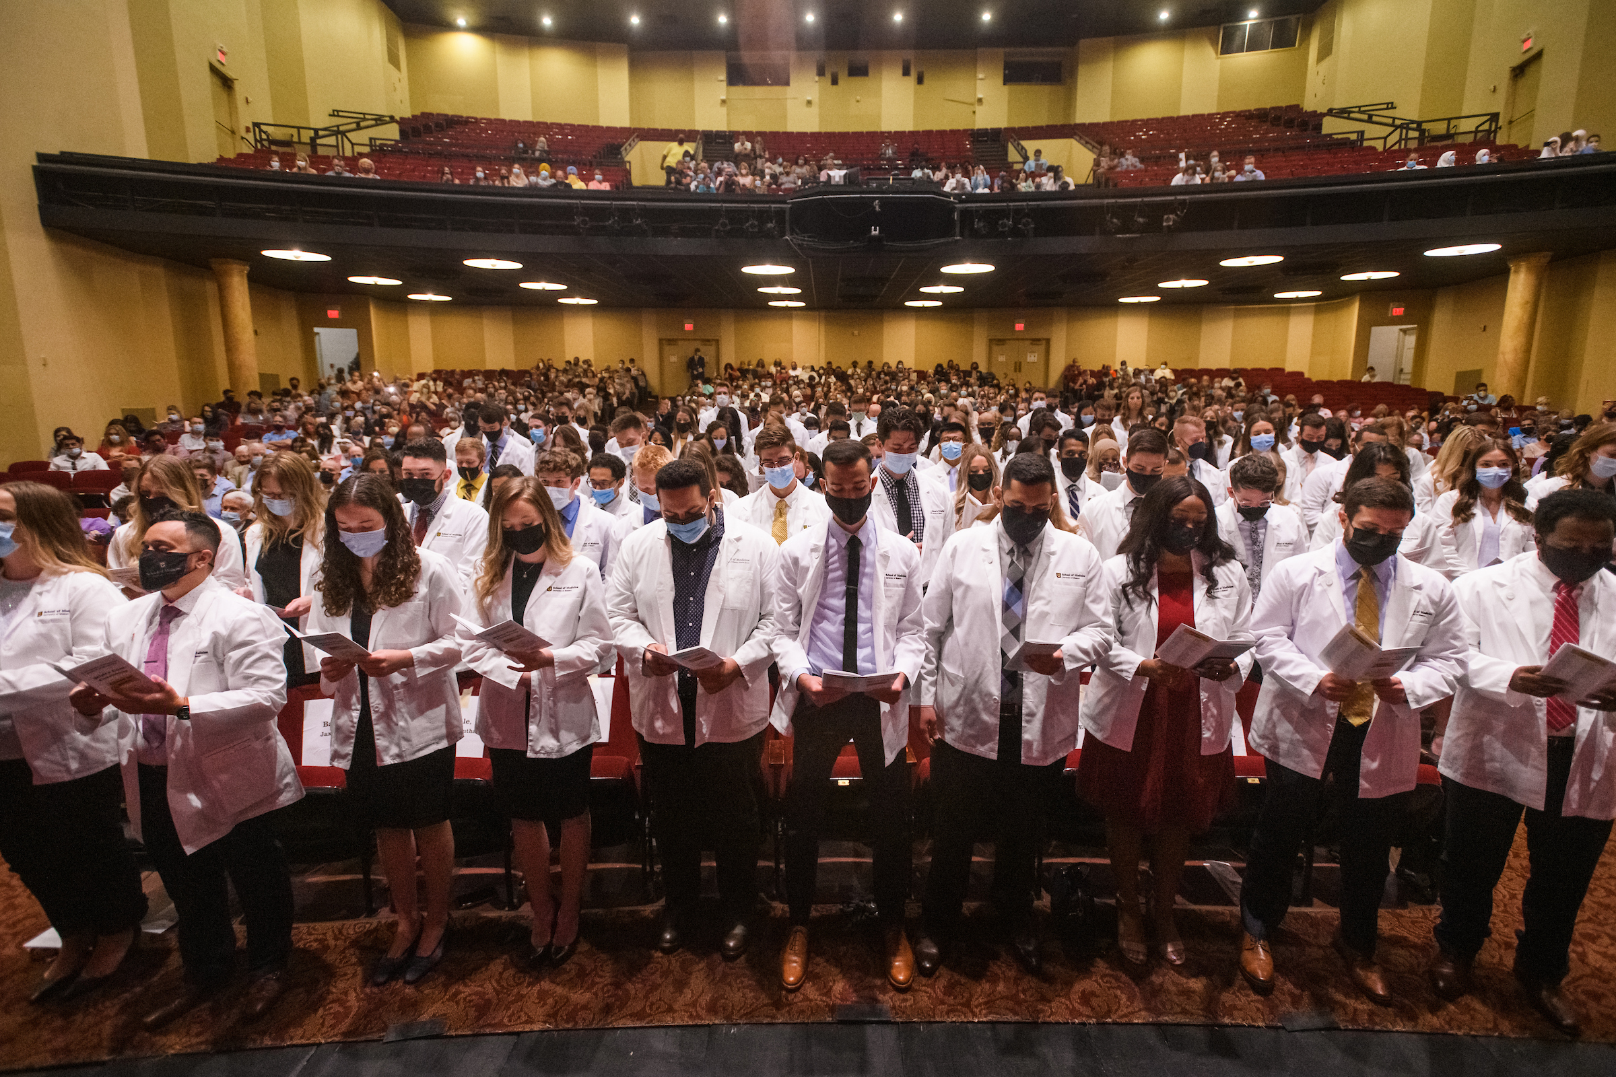
Welcoming our Medical Students - Class of 2025

Slide 7
MU Health Care
  Quality and Safety – Best two-year performance ever for MU Health Care based upon Vizient rankings of AMCs. #21 in 3rd Quarter (out of 101)
  Financially – FY 2021 was a very strong year coming out of COVID-19 shutdown.
  Market Share – Clinical Demand is strong and growing. Inpatient market share is at record levels.
  Next Steps – Children’s Hospital, ambulatory space consolidations, Jefferson City strategy, and payer partnerships.

Slide 8
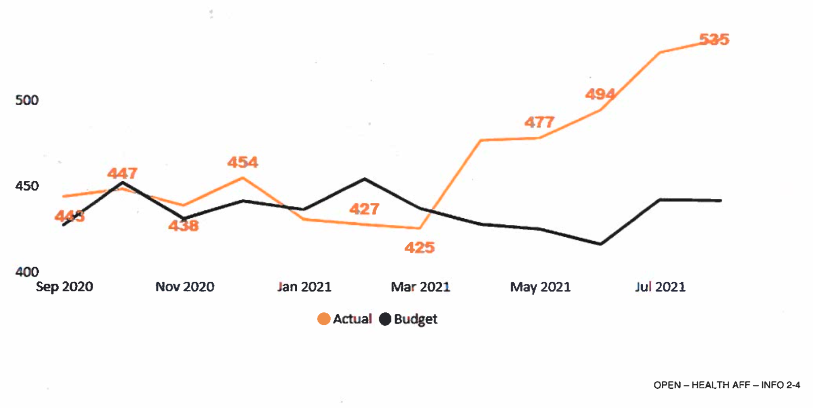
MU Health Care’s Average Daily Census

Slide 9
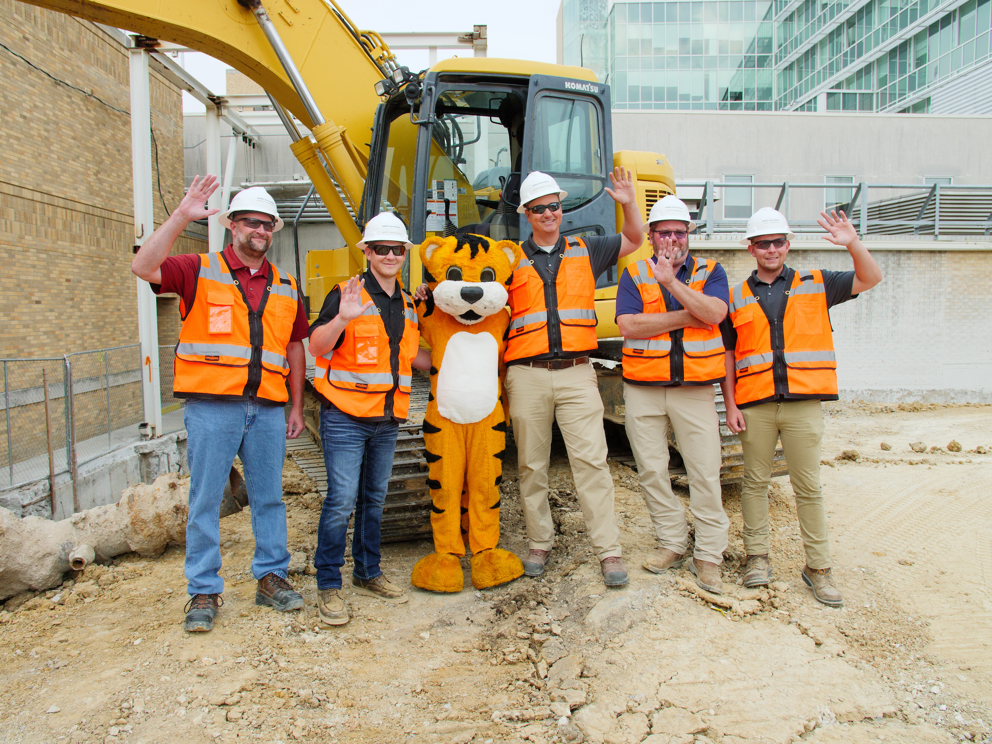
Children’s Hospital Groundbreaking Celebration Friday, Oct. 1
Program and Live Stream
Time: 3:00 p.m.
Location: Construction site, between Pershing Hall and Lake Street
Program: Beginning at 3:15 p.m.; live stream option for those unable to attend in person
Reception
Time: 4:00 – 5:00 p.m.
Location: Between Pershing Hall and Lake Street

Slide 10

UnitedHealthcare Community Plan
Now back in network for UnitedHealthcare Community Plan, the insurer’s managed Medicaid offering
Capital Region Medical Center also is in network for this plan
Working on larger payor strategy to reconnect with patients we have lost because of this transition

Slide 11
CORPORATE INTEGRITY AGREEMENT - Year End
CIA Reporting Period (RP) 5
July 1, 2020 – June 30, 2021
HAC approved CIA resolution on August 26, 2021
Final report due no later than October 1, 2021

Slide 12
Challenges
  COVID pandemic impacts on education, patient care and research
  Clinical growth required to support academic mission
  Financial impact of revenue pressures
    Uncertainty of Medicaid expansion
    Medicaid Managed Care negotiations
  Recruitment and retention of faculty and staff

Slide 13
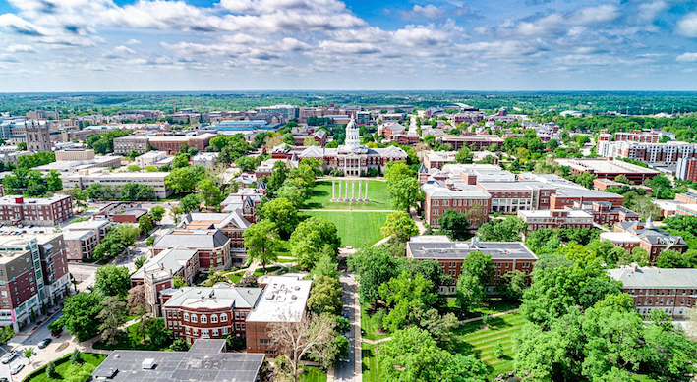
Thank You!
  Questions?

